Slide 1
Credit Card Fraud Detection Using Machine Learning

Slide 2
Overview
Problem statement:
The increasing prevalence of credit card fraud in the digital era necessitates the development of robust and efficient fraud detection systems. This project aims to develop a machine-learning model to detect credit card fraud. The model will be trained on a dataset of historical credit card transactions and evaluated on a holdout dataset of unseen transactions.
Business Problem Overview:
For many banks, retaining high profitable customers is the number one business goal. Banking fraud, however, poses a significant threat to this goal for different banks. In terms of substantial financial losses, trust and credibility, this is a concerning issue to both banks and customers alike.
It has been estimated by Nilson report that by 2020 the banking frauds would account to $30 billion worldwide. With the rise in digital payment channels, the number of fraudulent transactions is also increasing with new and different ways.
In the banking industry, credit card fraud detection using machine learning is not just a trend but a necessity for them to put proactive monitoring and fraud prevention mechanisms in place. Machine learning is helping these institutions to reduce time-consuming manual reviews, costly chargebacks and fees, and denials of legitimate transactions.
Project Goal:
The main aim of this project is the detection of fraudulent credit card transactions, as it is essential to figure out the fraudulent transactions so that customers do not get charged for the purchase of products that they did not buy.

Slide 3
Data Description
Data Description: The dataset was retrieved from an open-source website, Kaggle.com. It con- tains data on transactions made in 2013 by European credit card users in two days only. The dataset consists of 31 attributes and 284,808 rows.
Twenty-eight attributes are numeric variables that, due to the confidentiality and privacy of the customers.
Time: which contains the elapsed seconds between the first and other transactions of each Attribute.
Amount : Which is the amount of each transaction
Class : which contains binary variables where 1 is a case of fraudulent transaction, and 0 is not as case of fraudulent transaction.
Dataset: https://www.kaggle.com/datasets/mlg-ulb/creditcardfraud

Slide 4
Methodology
Data collection:
The first phase involves collecting a dataset of historical credit card transactions. The dataset will be sourced from Kaggle.com, a popular platform for datasets and machine learning challenges.
Data Cleaning:
Impute the missing values with the column's mean, median, or mode.
Drop the rows with missing values.
Use a machine learning model to predict the missing values like isnull() and heatmap().
Normalize the data:
Normalization is scaling the data so that all features have similar values. This can improve the performance of machine learning models by making the parts more comparable.
Model training:
The second phase will involve training the machine learning model on the collected data.
The model will be prepared using a supervised learning algorithm like Logistic Regression and Random Forest
Model evaluation:
The third phase will involve evaluating the machine learning model's performance on a holdout dataset of unseen transactions. The model's performance will be evaluated using accuracy, precision, and recall metrics.

Slide 5
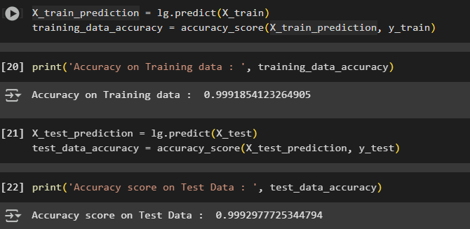
Results
Logistic Regression:
The last model created using Jupiter Notebook is Logistic Regression; the model managed to score an Accuracy on Training data of 99% , while it scored an Accuracy score on Test Data of 99%, as presented in blew Figure.

Slide 6
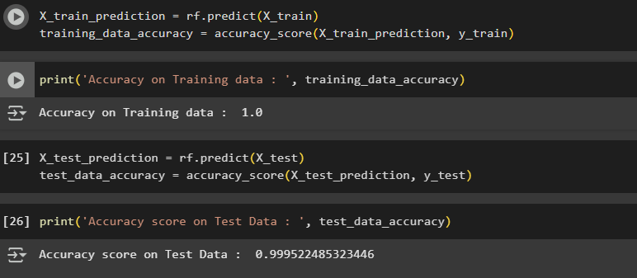
Random Forest
The last model created using Jupiter Notebook is Random Forest; the model managed to score an Accuracy on Training data of 100% , while it scored an Accuracy score on Test Data of 99%, as presented in blew Figure.

Slide 7
Conclusion:
The main objective of this project was to identify the most suitable machine learning model for credit card fraud detection. Two models Logistic Regression and Random Forest, were implemented and evaluated. Both achieved high accuracy, with Random Forest showing exceptional performance by detecting fraud with 100% accuracy. These results contribute to enhancing customer satisfaction by offering a more secure and reliable transaction experience.

